Slide 1
The Steps To CrossMart Analyses
EDM Group
Informational Technology Services
Humboldt State University
2/24/2014

Slide 2
HSU Data Marts
Enterprise Data Organized into 3 areas:
  Finance
  Human Resources
  Student
Data presented as Subject Areas
  Folder structure
  Field Selection
  Granularity

Slide 3

What is Grain?
Specifying the Level of Detail
  If more detail is included, the level of granularity is lower. If less detail is included, the level of granularity is higher.
  This applies both to the fact and to the dimensions

Slide 4
HSU Data Marts
Subject Area | Grain
Finance - General ledger | Transaction Event (payment, receipt, AJE)
HR - Job Events | Employee/Job/Event
HR - Job History | Employee/Job/Day
HR - Labor Cost | Paycheck
HSU - Census | Student/Term

Slide 5
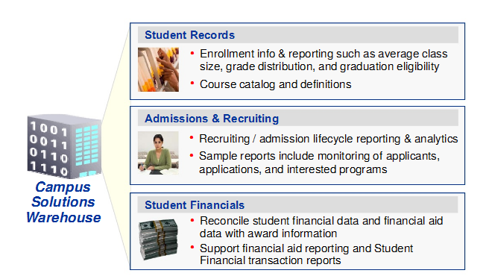
Data Marts – how information is organized in the Data Warehouse
Notes:
TWO OTHER MARTS:
Institutional Research -- area where snapshots are taken for comparative point-in-time analysis
Campus Community -- service indicators, events and communications

Slide 6
HSU Data Marts – Student EPM
Subject Area | Grain
CSW Admission Application | Student/Career/Application/Plan
CSW Admission Application Status | Student/Career/Application/Plan/Action Date
CSW Stdnt Fin Award Disbursement | Student/Career/FinAid item/Disbursement
CSW Student Financials Acctg Line | Accounting Line detail
CSW Student Financials Pmt Detail | Student/Payment
CSW Student Financials Trans Detail | Student/Transaction
CSW Student Records Acad Plan Summary | Student/Career/Plan
CSW Student Records Acad Prog Detail | Student/Career/Acad Program/Effective Date
CSW Student Records Class | Class
CSW Student Records Class Enrollment | Person/Class/Session
CSW Student Records Class Instructor | Course/Class/Session/Section/Mtg/Instructor
CSW Student Records Class Meeting Pattern | Course/Session/Section/Mtg/Instructor
CSW Student Records Student Degrees | Person/Degree#/Acad Plan/SubPlan
CSW Student Records Term Enrollment | Person / Term

Slide 7

Cross Mart
what does it mean?
Bringing information together from different subject areas
Ask questions like:
  What are the graduation rates of student workers compared to the rest of their cohort?
  What were the fees collected for students here at census?
OR, limiting the results of one Subject area based on the outcome of another

Slide 8


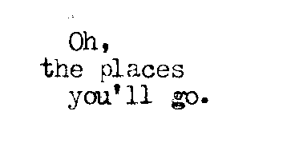
How do we do this?
Choose Subject areas with the same grain
Use “Conformed Dimensions” to be able to drill across subject areas
Work collaboratively to identify new subject areas

Slide 9
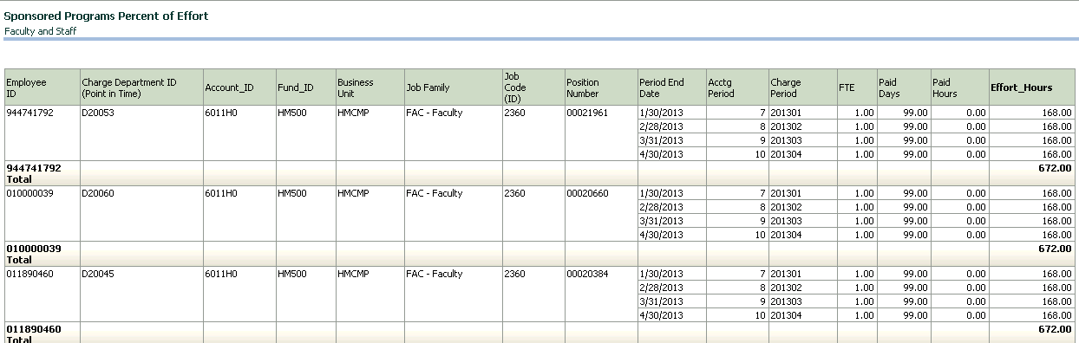
CrossMart Example
SPF Percent of Effort
Mandatory reporting for federally funded grants
Uses Labor Cost Data with population limits based on Job History

Slide 10
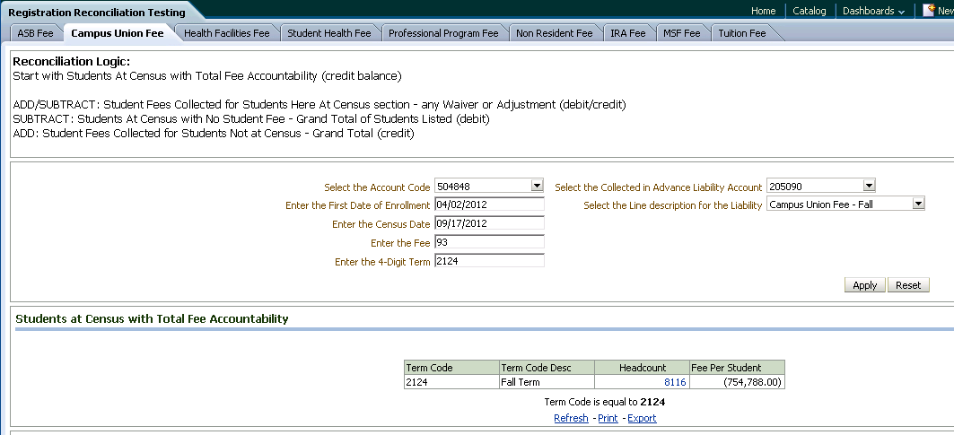
CrossMart Example
Student Fee Reconcilication
Work in progress to combine Student Financials with Census Data
Displays Finance – G/L data on the dashboard for verification

